Slide 1

Progress Seminar
On
“EVALUATION OF DESIGN AND FINITE ANALYSIS CREEP TEST APPARATUS ”
Presented By
Apurva Dogre
Anand Ade
Aman Tiwari
Aman Pachare
Rajat Talmale
Neeraj Shahare
In
Bachelor of Engineering (Mech. Engg.)
VII Semester
Guided By
Dr.-vijay Talodikar and Arvind Totey
Department of Mechanical Engineering
Tulsiramji Gaikwad-Patil College of Engineering & Technology
Rastrasant Tukdoji Maharaj Nagpur University
2022-2023
1

Slide 2
OUTLINE
Introduction
Literature Survey
Problem Statement
Objectives of the Project
Existing system (If any)
Proposed diagram
Proposed Working
Advantages
Limitations
Conclusion from research paper
References

Slide 3
Introduction
Creep can be defined as the slow and progressive (increasingly continuing) deformation of a material with time under a constant stress. It is both a time and temperature dependent phenomenon. Creep is probably the most widely studied long-term property. It results from the viscoelastic flow of the polymer with time. In other words, creep is a time-dependent process where a material under an applied stress exhibits a dimensional change at high temperature. High temperature progressive deformation of a material at constant stress is called creep.
The process is also temperature-dependent (i.e. increases with temperature).Normally, Creep occurs when vacancies in the material migrate toward grain boundaries that are oriented normal to the direction of the applied stress. Different mechanisms are responsible for creep in different materials and under different loading and temperature conditions. Creep failure of machine elements in many industries such as nuclear plants, spacecraft, petrochemical and metallurgical processing has been reported in literature

Slide 4
Literature Survey
Sr.no | Title of the paper | Author | Name of general/ISSI NO/Volume number/Year | Conclusion of research paper
1. | Computer simulation and high temperature creep behaviour of (CRMO) steel | S. Hore R.N.Ghose | Material science engineering a whole 528/2011 | The purpose of this work was to modify the tensile creep testing machine,which was designed and fabricated by previous batch student.
2. | Creep-fatigue interaction damage model and its application in modified 9Cr-1Mo stee | G.Zhang, , Y. Zhao Xue et Al | Nuclear Engineering and Design, Vol. 241, Issue12, Pages 4856–4861, 2011. | engineering knowledge of mathematics, science, engineering fundamentals and engineering specialization to the solution of complex engineering problem of creep behaviour..
3. | Standard Test Methods for Conducting Creep, Creep-Rupture, and Stress-Rupture Tests of Metallic Materials | ASTM E 139-00 | ASTM International, Pages 296-307, 2003. | Study of research literature has to analyse the three phases of creep ie the transient steady state and accelerated creep phases

Slide 5
Problem Statement
There are numerous issue related with creep testing machine. There are identified during exhaustive literature survey.
The various changes will be suggested with respect to proposed design and further then analyses to solve the operating problems on creep testing machine .
FEM Analysis of creep behavior of composite requires special efforts in designing and simulation of creep testing machine

Slide 6
Objectives of the Project
The main objective of this research work is to design a each part of creep testing machine using design data book...
The second objective is to computer analysis on FEM/ANSYS of creep testing machine design to investigate critical operating issues during static and dynamic condition.
The proposed design of machine will address the issues related with machine which will get resolved after computerized simulation process at different conditions and parameters.

Slide 7
Existing system
Existing mechanically operated tensile and creep testing machine was modified to a low cost, electro-mechanically operated creep testing machine capable of determining the creep properties of aluminum.
lead and thermoplastic materials as a function of applied stress, time and temperature. The modification of the testing machine was necessitated .

Slide 8
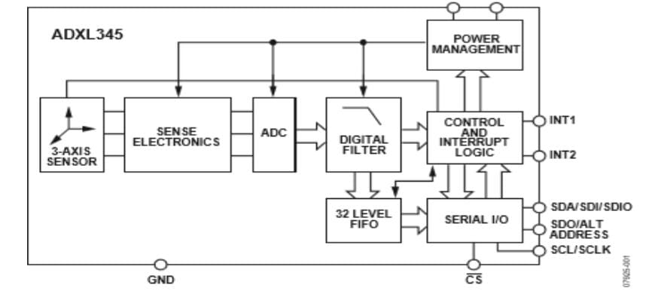
Proposed diagram
Research paper 4

Slide 9
Proposed Working
The creep test is conducted using a tensile specimen to which a constant stress is applied, often by the simple method of suspending weights from it.
Surrounding the specimen is a thermostatically controlled furnace, the temperature being controlled by a thermocouple attached to the gauge length of the specimen, Fig.
primary creep, secondary creep and tertiary creep. The creep curves provide information about the creep behavior over a specified period of time.
The device generates a creep time-dependent curve by calculating the steady rate of creep in reference to the time it takes for the material to change.

Slide 10
Advantages
The creep test is conducted using a tensile specimen to which a constant stress is applied, often by the simple method of suspending weights from it.
Surrounding the specimen is a thermostatically controlled furnace, the temperature being controlled by a thermocouple attached to the gauge length of the specimen, Fig.
primary creep, secondary creep and tertiary creep. The creep curves provide information about the creep behavior over a specified period of time.
The device generates a creep time-dependent curve by calculating the steady rate of creep in reference to the time it takes for the material to change.

Slide 11
Limitations
Conventional creep testing suffers from two main weaknesses.
it takes a long time to obtain results.
it generates results with wide scatter.

Slide 12
Conclusion from research paper
1. The purpose of this work was to modify the tensile creep testing machine,which was designed and fabricated by previous batch student.
2. This work was carried out by applying basic engineering knowledge of mathematics, science, engineering fundamentals and engineering specialization to the solution of complex engineering problem of creep behaviour regarding polymers like polypropylene and soft material like lead.
3. Study of research literature has to analyse the three phases of creep ie the transient steady state and accelerated creep phases. Long term creep behaviour and short term creep behaviour of polymer was studied to arrive at substantial conclusions.

Slide 13
References
S. Hore, R. N. Ghosh, ―Computer simulation of the high temperature creep behaviour of Cr-Mo steels,‖ Materials Science and Engineering A, Vol. 528, Issue19-20, Pages 6095–6102, 2011.
G. Zhang, Y. Zhao, F. Xue et al., ―Creep-fatigue interaction damage model and its application in modified 9Cr-1Mo steel,‖ Nuclear Engineering and Design, Vol. 241, Issue12, Pages 4856–4861, 2011.
ASTM E 139-00, ―Standard Test Methods for Conducting Creep, Creep-Rupture, and Stress-Rupture Tests of Metallic Materials‖, ASTM International, Pages 296-307, 2003.
E E Granda-Gutierrez, S I Perez-Aguilar, F de J Fuentes-Torres, J C Díaz-Guillén, A Campa-Castilla, A Garza-Gómez, J Candelas-Ramírez, R Méndez-Méndez, ―System For Data Acquisition And Storage With Application in A Creep Test Machine‖, ITCHElectro,Vol.22 , Issue 1-3Pages 302-307, 2010.
Z. Z. Gao, W. Liu, Z. Q. Liu, and Z. F. Yue, ―Experiment and Simulation Study on the Creep Behavior of PMMA at Different Temperatures‖, Polymer-Plastics Technology and Engineering, Vol.49, Issue 14, Pages1478–1482, 2010

